Slide 1
Ensemble Methods

Slide 2
Classifier
Different Classifiers
Conduct classification on a same set of class labels
May use different input or have different parameters
May produce different output for a certain example
Learning Different Classifiers
Use different training examples
Use different features

Slide 3
Classifier
Performance
Each of the classifiers is not perfect
Complementary
Examples which are not correctly classified by one classifier may be correctly classified by the other classifiers
Potential Improvements?
Utilize the complementary property

Slide 4
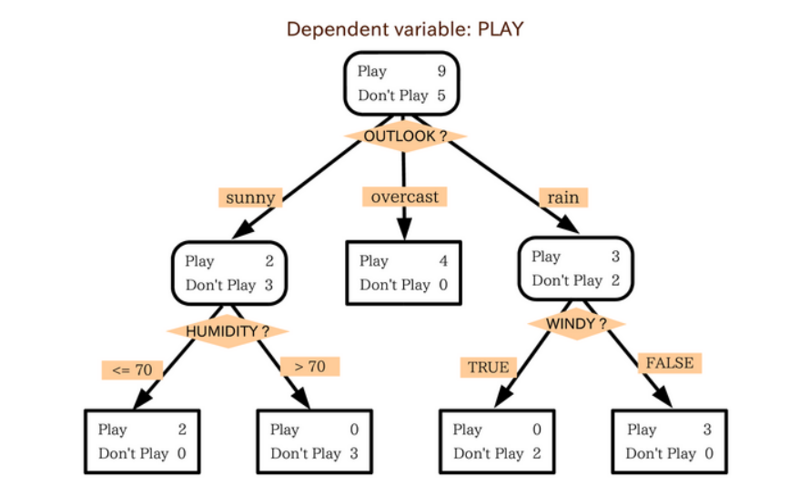
Decision Tree
Should we play outside?

Slide 5
Decision Tree
Decision Trees can also solve quantitative problems
When making Decision Trees, there are several factors we must take into consideration:
On what features do we make our decisions on?
What is the threshold for classifying each question into a yes or no answer?
What if we wanted to ask ourselves if we had friends to play with or not.

Slide 6
Decision Tree-Ensemble Method
Rather than just relying on one Decision Tree
Hoping we made the right decision at each split
Ensemble Methods allow us to take a sample of Decision Trees into account
Make a final predictor based on the aggregated results of the sampled Decision Trees.
Ensembles are predictive models that combine predictions from two or more other models.

Slide 7
Ensemble Method
Idea
Combine the classifiers to improve the performance
Ensembles of Classifiers
Combine the classification results from different classifiers to produce the final output
Unweighted voting
Weighted voting

Slide 8


Example: Weather Forecast
Reality
1
2
3
4
5
Combine
X
X
X
X
X
X
X
X
X
X
X
X
X

Slide 9
Ensemble Method
Ensemble methods is a machine learning technique that combines several base models in order to produce one optimal predictive model.

Slide 10
Ensemble Method
The models that contribute to the ensemble, referred to as ensemble members, may be the same type or different types and may or may not be trained on the same training data.
There are two main reasons to use an ensemble over a single model, and they are related they are:
Performance: An ensemble can make better predictions and achieve better performance than any single contributing model.
Robustness: An ensemble reduces the spread or dispersion of the predictions and model performance.

Slide 11
Types of Ensemble
Bagging
Random Forest(Classifier)
Boosting
ADA Boosting
Gradient Boosting
XgBoost

Slide 12
Types of Ensemble Methods
BAGGing, or Bootstrap AGGregating:
BAGGing gets its name because it combines Bootstrapping and Aggregation to form one ensemble model.
Given a sample of data, multiple bootstrapped subsamples are pulled.
A Decision Tree is formed on each of the bootstrapped subsamples.
After each subsample Decision Tree has been formed, an algorithm is used to aggregate over the Decision Trees to form the most efficient predictor.

Slide 13
Types of Ensemble Methods
What is Bootstrapping?
Bagging is composed of two parts: aggregation and bootstrapping. Bootstrapping is a sampling method, where a sample is chosen out of a set, using the replacement method. The learning algorithm is then run on the samples selected.
What is Aggregation?
Model predictions undergo aggregation to combine them for the final prediction to consider all the possible outcomes. The aggregation can be done based on the total number of outcomes or the probability of predictions derived from the bootstrapping of every model in the procedure.

Slide 14
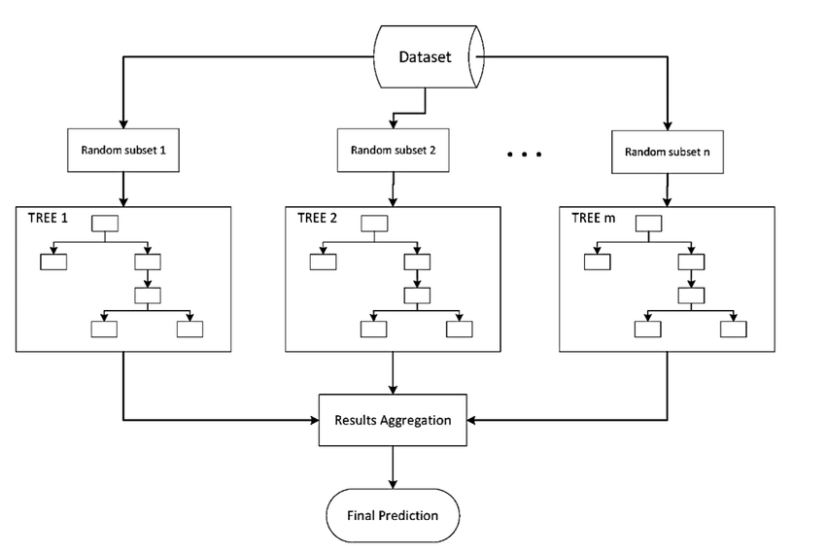

Slide 15
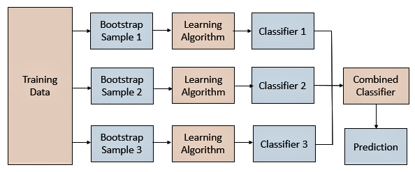

Slide 16
The bagging technique is useful for both regression and statistical classification.
Bagging is used with decision trees,
Raises the stability of models
Improving accuracy
Reducing variance
which eliminates the challenge of overfitting.

Slide 17
Bias-Variance
The errors made by a machine learning model are often described in terms of two properties: the bias and the variance.
The bias is a measure of how close the model can capture the mapping function between inputs and outputs. It captures the rigidity of the model: the strength of the assumption the model has about the functional form of the mapping between inputs and outputs.
The variance of the model is the amount the performance of the model changes when it is fit on different training data. It captures the impact of the specifics of the data has on the model.

Slide 18
Bosting
Boosting is an ensemble learning technique that uses a set of Machine Learning algorithms to convert weak learner to strong learners
Ensemble learning is a method that is used to enhance the performance of Machine Learning model by combining several learners.
When compared to a single model, this type of learning builds models with improved efficiency and accuracy in order to increase the accuracy of the model.

Slide 19
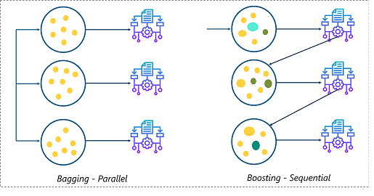
Bagging – Boosting

Slide 20
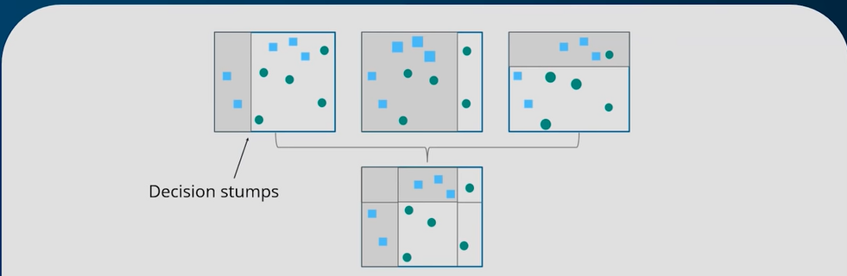
Boosting

Slide 21
Adaptive Boosting
AdaBoost is implemented by combining several weak learners into a single strong learner.
The weak learners in AdaBoost take into account a single input feature and draw out a single split decision tree called the decision stump. Each observation is weighed equally while drawing out the first decision stump.
The results from the first decision stump are analyzed and if any observations are wrongfully classified, they are assigned higher weights.
Post this, a new decision stump is drawn by considering the observations with higher weights as more significant.
Again if any observations are misclassified, they’re given higher weight and this process continues until all the observations fall into the right class.
Adaboost can be used for both classification and regression-based problems, however, it is more commonly used for classification purpose.

Slide 22
Gradient Boosting
Gradient Boosting is also based on sequential ensemble learning.
The difference in this type of boosting is that the weights for misclassified outcomes are not incremented, instead, Gradient Boosting method tries to optimize the loss function of the previous learner by adding a new model that adds weak learners in order to reduce the loss function.
The main idea here is to overcome the errors in the previous learner’s predictions. This type of boosting has three main components:
Loss function that needs to be ameliorated.
Weak learner for computing predictions and forming strong learners.
An Additive Model that will regularize the loss function.
Like AdaBoost, Gradient Boosting can also be used for both classification and regression problems.

Slide 23
XGBoost
XGBoost is an advanced version of Gradient boosting method
The main aim of this algorithm is to increase the speed and efficiency of computation

Slide 24
XGBoost
XGBoost is designed to focus on computational speed and model efficiency. The main features provided by XGBoost are:
Parallelly creates decision trees.
Implementing distributed computing methods for evaluating large and complex models.
Using Out-of-Core Computing to analyze huge datasets.
Implementing cache optimization to make the best use of resources.

